Slide 1
Maze Solving Robot
The University of Tennessee at Martin
Charles Clayton
John Buckley

Slide 2
Abstract
This project will implement different maze finding algorithms both physically, with a pi-bot, and virtually, with a random maze generator. We will compare results to see if one algorithm is better than another.

Slide 3
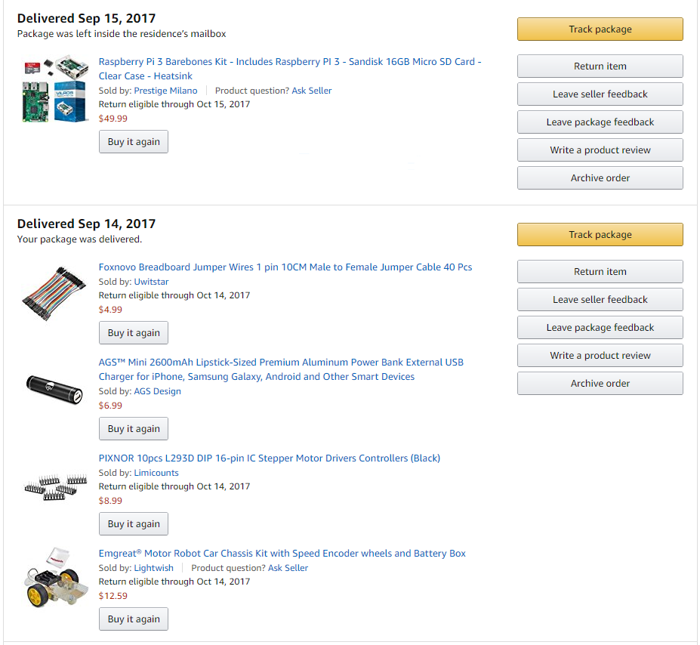

Hardware Used ($90.54 total)

Slide 4
Circuit
TBA (lack picture until other sensors are attached)
Go into motor board usefulness

Slide 5
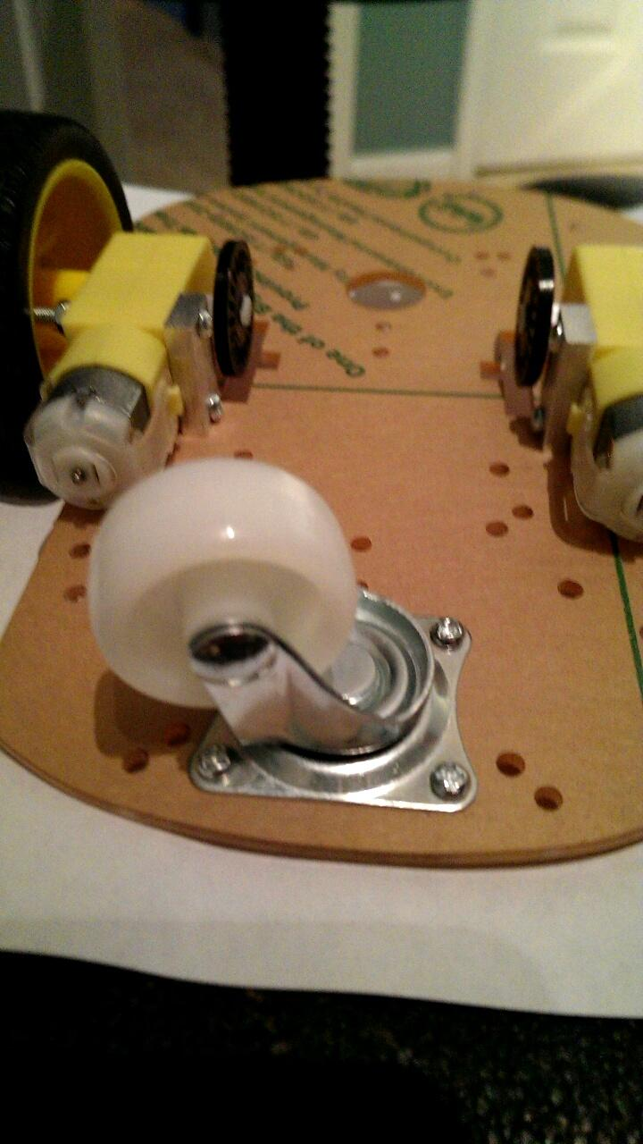
Initial Build
Lack 1 picture, to be taken later

Slide 6
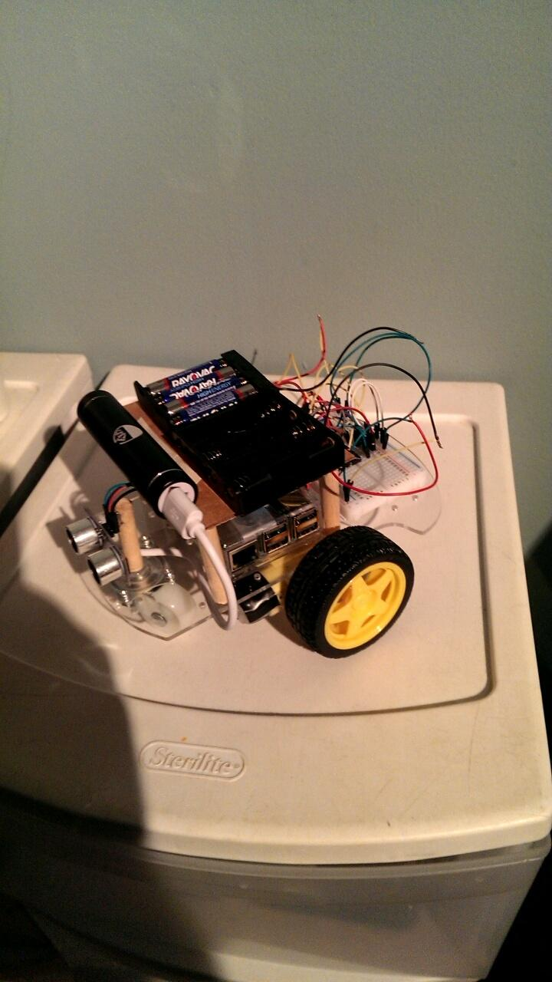
Second Build
Mount made for additional power storage. Build scrapped after solving circuit issues, no need for second battery pack.
Note: (No battery packs technically needed as it would run off power supplied by the pi after the fix, however opted to keep power to motors separate from the sensors as many more sensors will be added in the future.)

Slide 7
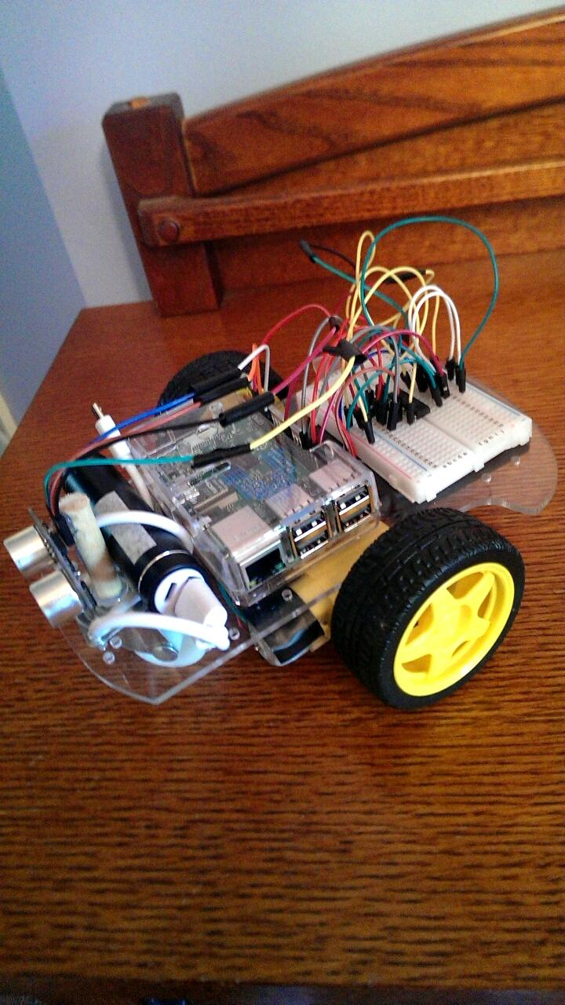
Third Build
Battery pack mounted under chassis to conserve room. Possible weight imbalance, if additional sensors don’t even out enough then weights will be added to the front of chassis.

Slide 8
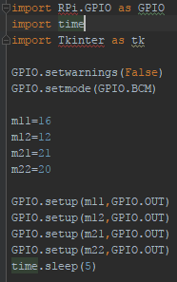
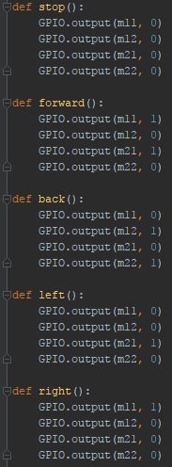
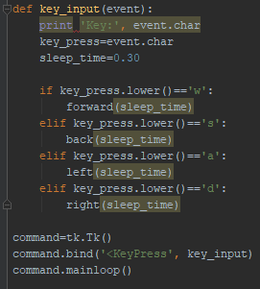
Manual Control
Define Movement
Initialization
Assign Key Commands

Slide 9
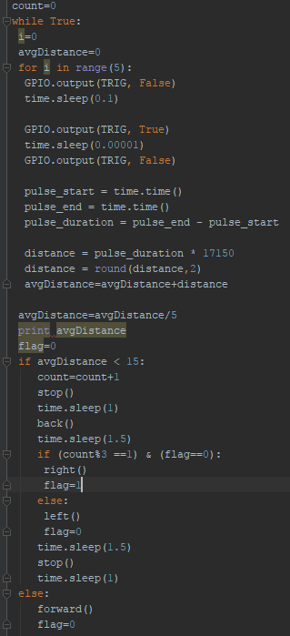

Obstacle Avoidance
Front Ultrasonic Sensor:
If obstacle is detected within 15cm; stop(), back(), and either left(), or right().
Recycle code for manual control
Additional Initialization

Slide 10
Initial Problems
Not enough power to drive motors from Pi
Not enough power to drive motors with 4 AA batteries
Batteries were quickly drained
All the above fixed with reworked circuit, possible short circuiting
Weight balancing on chassis

Slide 11
Algorithms
Left/right hand on wall
Simple obstacle avoidance
Random Mouse

